Slide 1
ICG/NEAM Tsunami Warning System
Accreditation Procedure of CTSPs
September 26-28, 2016
Bucharest, ROMANIA

Slide 2
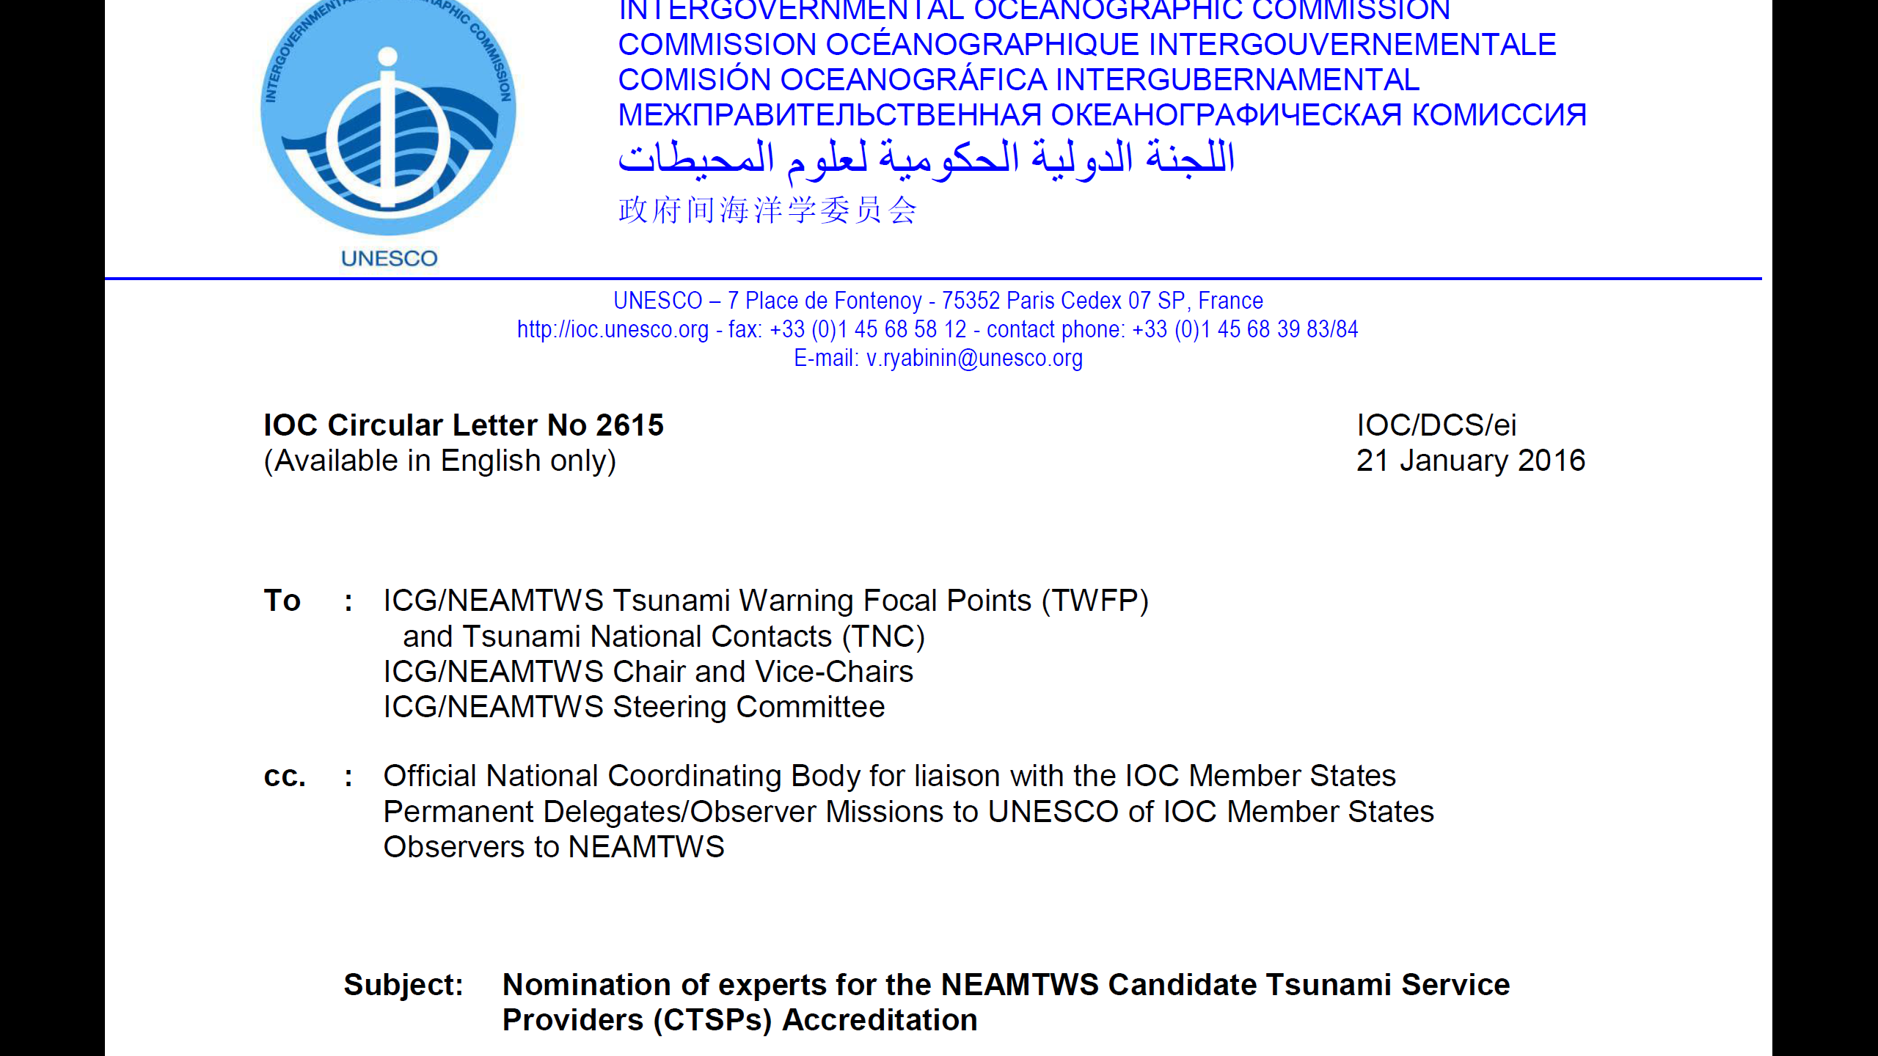
NEAMTWS Accreditation Team:
- one expert of NEAM Member States with a Candidate TSP or TSP
- one expert of another NEAM Member state
- plus one expert

Slide 3
The tsunami watch operations of Candidate Tsunami Service Providers (CTSPs) were reviewed by two different accreditation teams (ATs). CTSPs have provided a number of documents, describing the details of operations as well as infrastructure and human resources. Furthermore, in the “Procedures for the Accreditation of TSP ”document agreed at the ICG/NEAMTWSXII in Dublin, Ireland, 16-18 Nov. 2015, a number of functions and requirements are listed that need to be fulfilled and are individually addressed in a form, provided by the UNESCO ICG/NEAMTWS secretariat.

Slide 4
Detailed TSP Functions and requirements Adopted at ICG/NEAMTWS IX and modified according to ICG/NEAMTW XII recommendations
I. Watch Functions WF1 Disseminate watch and cancellation messages based on the alert-level decision matrix (or alternatively their own best practice) to all NTWCs and the TWFPs, and all eligible subscribers with no restriction. These best practices include scenario databases or other methods, these methodologies needing to be documented in the interim NEAMTWS Operational Users Guide. WF2 Reception and interpretation of real-time seismic measurements WF3 Determination of seismic parameters WF4 Exchange seismic parameters and information with other CTSPs, TSPs and NTWCs WF5 Reception and interpretation of real-time sea-level measurements WF6 Forecasting of tsunami arrival times and level of alert at each forecasting point specified by Member States WF7 Exchange sea level data and information with other CTSPs, TSPs and NTWCs WF8 Monitoring of tsunami propagation and disseminate updated information in priority tsunami amplitude measurements to all NTWCs and the TWFPs, and all eligible subscribers with no restriction

Slide 5
II Above and beyond watch time Functions
AF1 Monthly internal tests of the watch system
AF2 Actively participate in communication and tsunami exercises
AF3 Contribute to training courses in coordination with IOC
AF4 Participate actively in, and report to, the ICG and working groups and task teams

Slide 6
II Requirements
R1 Nominated and act as NTWC
R2 Real-time alert reception and transmission systems including GTS, Internet, fax
R3 Redundancy
R4 24/7 watch staff
R5 Operational manual describing procedures and documentation to TSPs
R6 Seismic expertise
R7 Direct access to large earthquakes data base
R8 Real-time transmission systems for reception of seismic data
R9 Tsunami and sea level expertise
R10 Direct access to a tsunami data base
R11 Real-time transmission systems for reception of sea level data
R12 Tsunami modelling capacity for tsunami travel time computation

Slide 7
ACCREDITATION TEAMS

Slide 8
ACCREDITATION PROCEDURE

Slide 9
ACCREDITATION OUTCOME
According to the reports all four centres have fully met the mandatory requirements and functions
Officers have evaluated and approved the reports
ICG will be asked to discuss outcomes and approve the Accreditation
The Chair and Vice Chairs in cooperation with Accreditation Team leaders, Steering Committee, and UNESCO will prepare a final report for publication
It is suggested to hold a short Accreditation Ceremony at the next IOC General Assembly in June 2017

Slide 10
GENERAL RECOMMENDATIONS
In coordination with ICG and other TSPs
Implement more systematic performance monitoring scheme
Implement a more reproducible scheme for defining forecast points
Make use of numerical modeling of tsunami propagation for routine operations
Implement/densify RT/NRT sea level network

